Slide 1
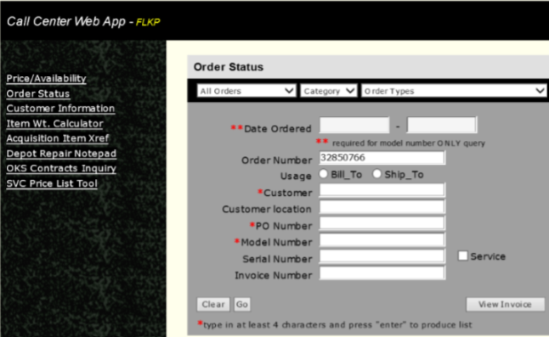
CURRENT EXISTING PROBLEM STATEMENT
Depot Repair notes are a critical feedback mechanism for front-end users like Customer Service Agents (CSA) who are in direct contact with end customers. These notes contain the narratives of technicians and service agents regarding the instrument’s service journey through the Fluke/SSO lab(s). The details of customer products are captured within Oracle EBS but are distributed across multiple modules, each capturing different parts of the details.
Multiple Modules: Information is spread across Oracle OM Module, Depot Repair Modules, and a custom Call Center Tool.
Time-Consuming: Collecting and synthesizing information from various screens is slow and inefficient.
Complex Jargon: Technician notes can be cryptic and hard to interpret.
High Call Volume: Over 70 CSAs handle more than 6,000 calls annually, making the current process unsustainable.
The call center web tool is the primary choice for the CSA users who are in contact with the customer

Slide 2
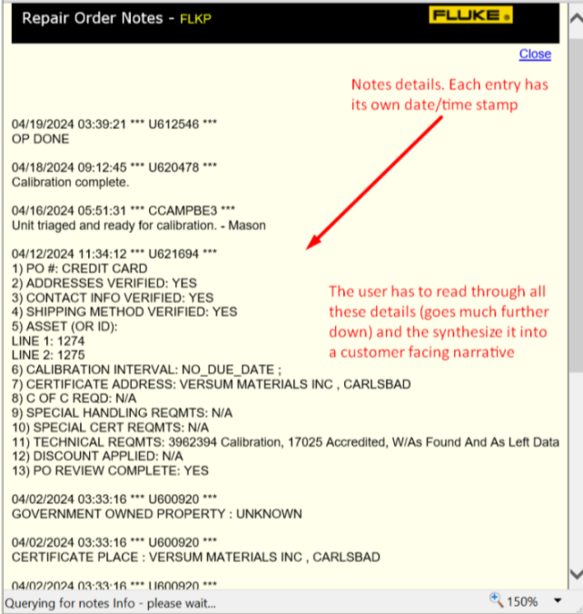
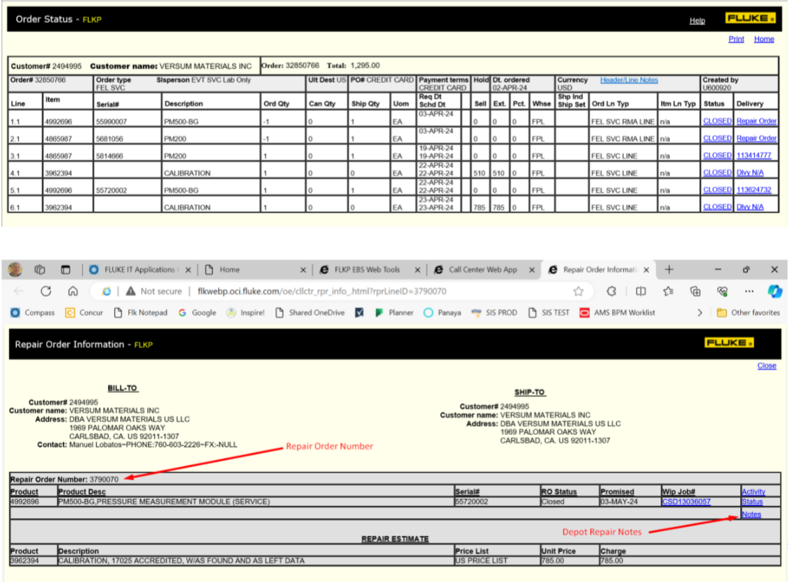
First screen upon querying the call center web tool: Displays only table details, need to go to “Repair Orders” for each repair within an RMA.
1
Screen on clicking on the Repair number link, shows another table with “Notes” as link to the customer agent written note.
Third screen with notes details, CSA or user has to go through complete details and create a narrative out of it for customer.
2
3

Slide 3
The solution involves an AI based chatbot with backend Oracle access using SQL scripts to find relevant Repair Orders (ROs) and attached Notes, providing real-time feedback without delays and provide a proper narrative to the customer.
Use Case Description and Value Add of Our Solution
Faster Access: Direct database queries are quicker than using external sources.
Real-Time Data: Eliminates data gaps by accessing current information.
Simplified Expansion: SQL scripts streamline parameter adjustments.
Reduced Maintenance: No need for external data storage or safeguarding.
Enhanced Comprehension: Incorporating LLM (Large Language Model) capability to convert technician notes into clear, concise summaries improves understanding and communication.

Slide 4
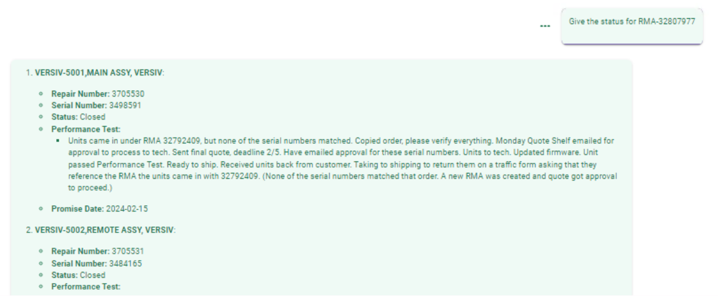
User can directly query on the RMA number to get the complete details of RO within it.
Every RO number consists of all the details like “Repair Number”, “Serial Number”, “Status”, “Notes Summary”,”Promise Date” and also the “Waybill No.”, all at once.

